Slide 1
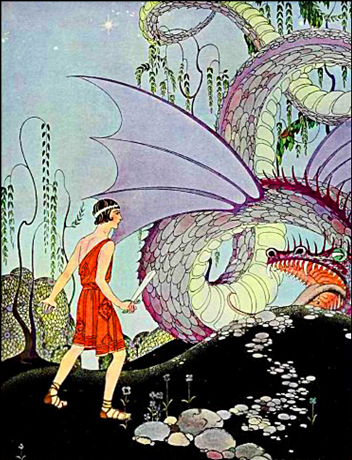
L
I
T
E
R
A
T
U
R
E
John Chiappone Copyright © 2017
Notes:
Pictures are from the Tanglewood Tales by Nathaniel Hawthorne.

Slide 2
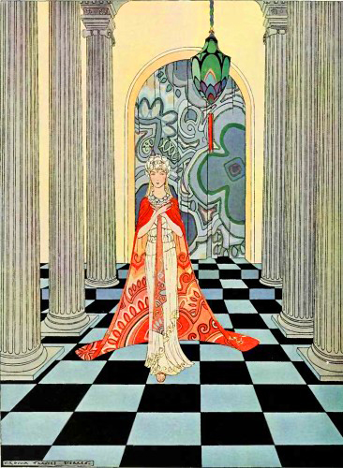
Types of Literature
1. Fiction
2. Nonfiction
3. Drama
4. Poetry

Slide 3

FICION: (nonfactual and imaginative)
Two Types:
Realistic (verisimilitude)
Nonrealistic (fantasy)
Two Categories:
Novel – A long work with many characters
Short Story

Slide 4

NOVEL:
TYPES OF SUBJECT MATTER:
1. Sociological-panoramic:
covers many years and settings
2. Dramatic-intimate:
covers a restricted time and setting

Slide 5
TYPES OF NOVELS:
1. Epistolary – told through letters (Color Purple)
2. Gothic – medieval mystery and terror
3. Historical – realistic epoch (place & time)
4. Manners – social customs
5. Picaresque – adventures of a traveler
6. Psychological
7. Sentimental – exaggerated emotions

Slide 6

SHORT STORIES:
Usually a single scene with underdeveloped characters. Fables and folklores are examples. In a fables the characters are animals, and there is a moral to the story. (Aesop’s Fables)

Slide 7

NONFICTION: (factual)
TYPES:
1. Biography – about a person’s life
2. Hagiography – about a religious person
3. Essay – nonfiction
Informal – brief, conversational, loose structure
Formal – longer, structured, and impersonal
4. Speech

Slide 8
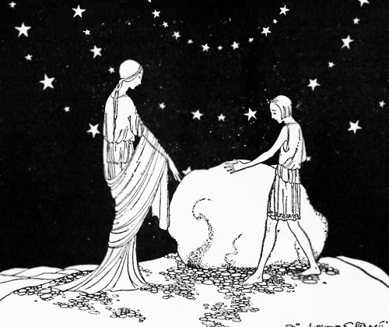
TECHNICAL DEVICES
Point of View (perspective)
Three Types:
1. First Person Singular – a character’s viewpoint
2. Third Person – two types:
a. Singular – a character not in the story
b. Omniscient – from all the characters’ perspective, or no character’s perspective

Slide 9
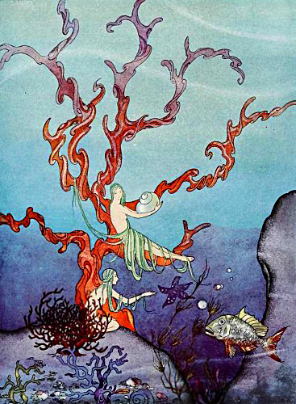
POETRY

Slide 10
POETRY
Peter Gabriel Mercy Street
Live in Milan 2003
Anne Sexton (1928 - 1974)
video | 45 Mercy Street | poems | life

Slide 11
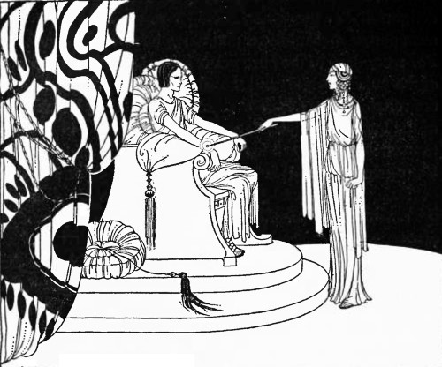
TYPES OF POETRY
LYRIC - A short poem that is sung (Love Rain).
NARRATIVE - Poems that tell a story.
CONCRETE – The words are arranged in a picture.
FREE VERSE – Modern free form poetry.
- It has no ridged structure
- Does not necessarily rhyme
- Sounds conversational, and improvisational

Slide 12
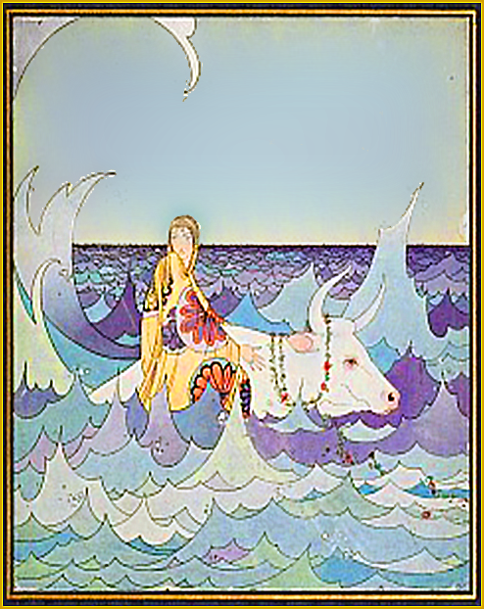
HAIKU
HAIKU - A three lined Japanese poem.
Five Syllables
Seven Syllables
Five Syllables
A still watered pond.
A rock that sits by the brook.
No ripples, no mind.
):(
John Chiappone
Notes:
John Chiappone – Chapter 8

Slide 13

HAIKU
HAIKU –
Five Syllables
Seven Syllables
Five Syllables
Collaborate:
Write a Haiku Poem
Notes:
John Chiappone – Chapter 8

Slide 14
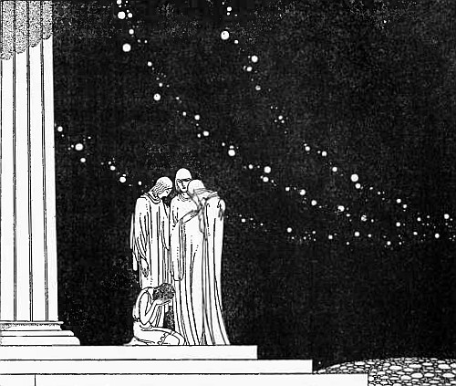
IMPORTANT CONCEPTS
POET - the author of a poem.
SPEAKER - the narrator of a poem.
LINE - A line of the poem.
STANZA – A paragraph in a poem.
FORM - The appearance of the words on the page.
IMAGERY – The perceptions caused by reading - like sights, sounds, tastes, or tactile sensations.

Slide 15
METAPHOR - A direct comparison of two things;
Juliet is the Sun, and I am moon.
SIMILE – An indirect comparison of things;
Juliet is like the Sun, and I resemble the moon.
HYPERBOLE – Exaggerated figure of speech used to create emphasis; the path went on forever.
ONOMATOPOEIA - Words that imitate sounds:
Buzz , oink, meow, roar, zip, and zap.

Slide 16
PERSONIFICATION - Giving anthropomorphic (human) qualities to animals or inanimate objects:
“Arise fair sun, and kill the envious moon.”
REVERSE PERSONIFICATION - Giving inanimate or animal qualities to people:
I am the sky. I am the birds that fly.
ANASTROPHE - Inversion of normal word order:
Truly wonderful the mind of a child is. Yoda

Slide 17
STANZA - a paragraph or group of lines.
As I was sitting in my chair,
I knew the bottom wasn't there,
Nor legs nor back, but I just sat,
Ignoring little things like that.

Slide 18
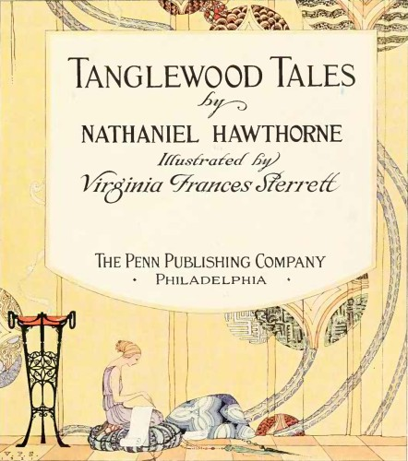
TYPES OF STANZA
Couplet - 2 lines
Triplet - 3 lines
Quatrain - 4 lines
Quintet - 5 lines
Sestet - 6 lines
Septet - 7 lines
Octave - 8 lines

Slide 19
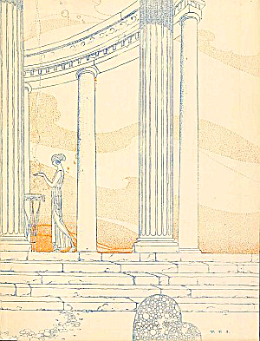
STRUCTURE
Lines with the same
number of words,
syllables, accents,
rhyme etc.

Slide 20
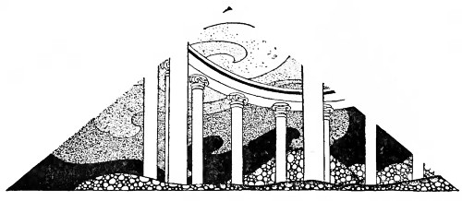
SOUND STRUCTURE
Four Types:
1. Rhyme – words that sound alike.
2. Alliteration – repeating an initial sound: Peter Piper picked a peck of pickled peppers.
3. Assonance – uses similar vowels: In Xanadu did Kubla Khan - by Coleridge
Mad as a Hatter
4. Consonance – repeated consonants: Susan’s Mississippi Sightseeing.

Slide 21
RHYTHM - The beat of a poem. Meter, rhyme, assonance, consonance, alliteration, and refrain contribute to rhythm.
FOOT – stressed and unstressed syllable patterns
TYPES OF FEET
Trochaic - stressed, unstressed
Dactylic - stressed, unstressed, unstressed
Iambic - unstressed, stressed
Anapestic - unstressed, unstressed, stressed

Slide 22
METER - A pattern of stressed and unstressed syllables on a line. Some types of meter are:
Monometer - 1 foot per line
Dimeter - 2 feet
Trimeter - 3 feet
Tetrameter - 4 feet
Pentameter - 5 feet
Hexameter - 6 feet
Heptameter - 7 feet
Octometer - 8 feet

Slide 23
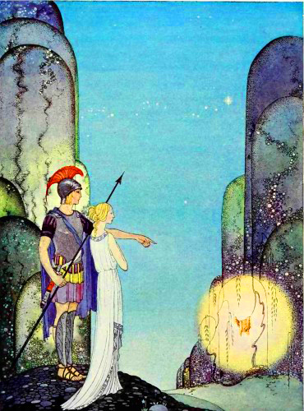
RHYME - Words sound alike
because they share the same
ending vowels and consonants.
FLOWER
POWER

Slide 24
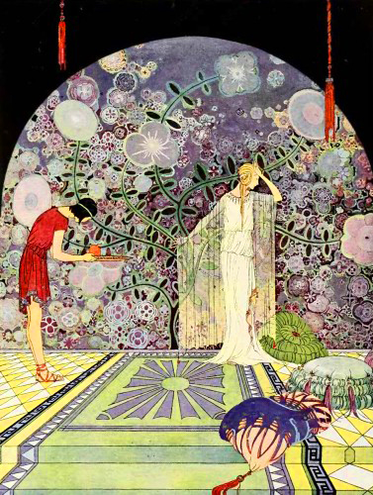
END RHYME
Words at the end of lines that rhyme.

Slide 25
Shall I compare thee to a summer's day?
Thou art more lovely and more temperate:
Rough winds do shake the darling buds of May,
And summer's lease hath all too short a date.
William Shakespeare

Slide 26
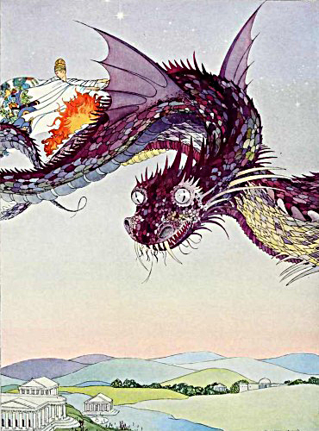
INTERNAL RHYME - Words that rhyme inside a line.
Upon a midnight dreary, while I pondered weak and weary.
- The Raven by Edgar Allan Poe

Slide 27
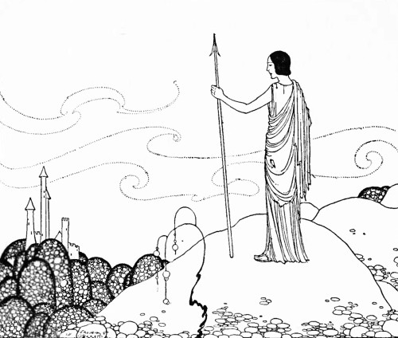
RHYME SCHEME - a pattern of rhymes
Bid me to weep, and I will weep - A
While I have eyes to see; - B
And having none, and yet I will keep - A
A heart to weep for thee. - B
Robert Herrick

Slide 28
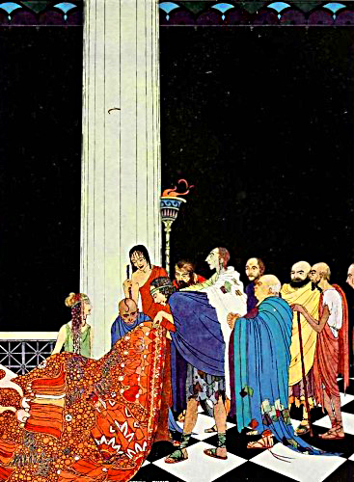
CONSONANCE
Repetition of the same consonant; all mammals named Sam are clammy.

Slide 29

ALLITERATION
Alliteration is a special case of consonance where the repeated consonant sound is at the beginning of each word, as in:
Peter Piper picked a peck of pickled peppers.

Slide 30
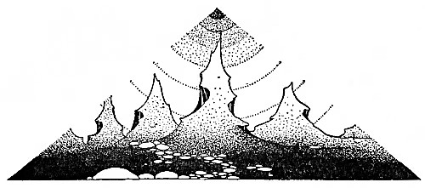
REFRAIN
A sound, word, phrase or line repeated regularly in a poem. For example President Obama’s speech: 'Yes, We Can Change'
Yes, we can. Yes, we can change. Yes, we can. … And where we are met with cynicism and doubt and fear and those who tell us that we can't, we will respond with that timeless creed that sums up the spirit of the American people in three simple words -- yes, we can.”

Slide 31
Collaborate
POETRY EXERCISE - 1
POETRY EXERCISE - 2

